Slide 1
Building Fair AI Models
Moninder Singh
IBM Research AI
PyData New York, 2018

Slide 2
Resources
Tutorial (This document + Notebooks):
https://github.com/monindersingh/pydata2018_fairAI_models_tutorial
Toolkit Used – AI Fairness 360 (AIF 360):
https://github.com/IBM/AIF360
AIF 360 Installation Instructions:
https://github.com/IBM/AIF360/blob/master/README.md
AIF 360 Dataset Download Instructions:
https://github.com/IBM/AIF360/tree/master/aif360/data

Slide 3
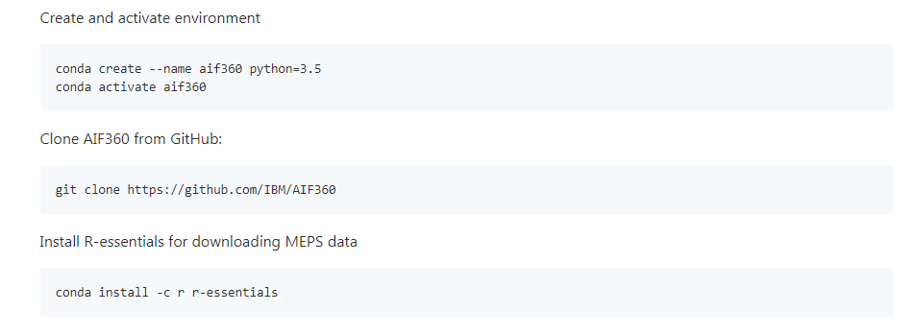
Alternative Setup Instructions
https://github.com/monindersingh/pydata2018_fairAI_models_tutorial/blob/master/README.md

Slide 4
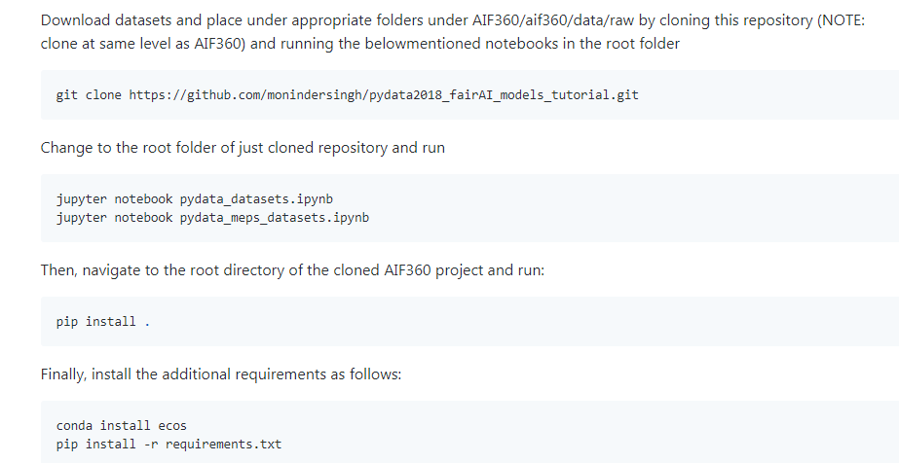
Alternative Setup Instructions (contd.)

Slide 5
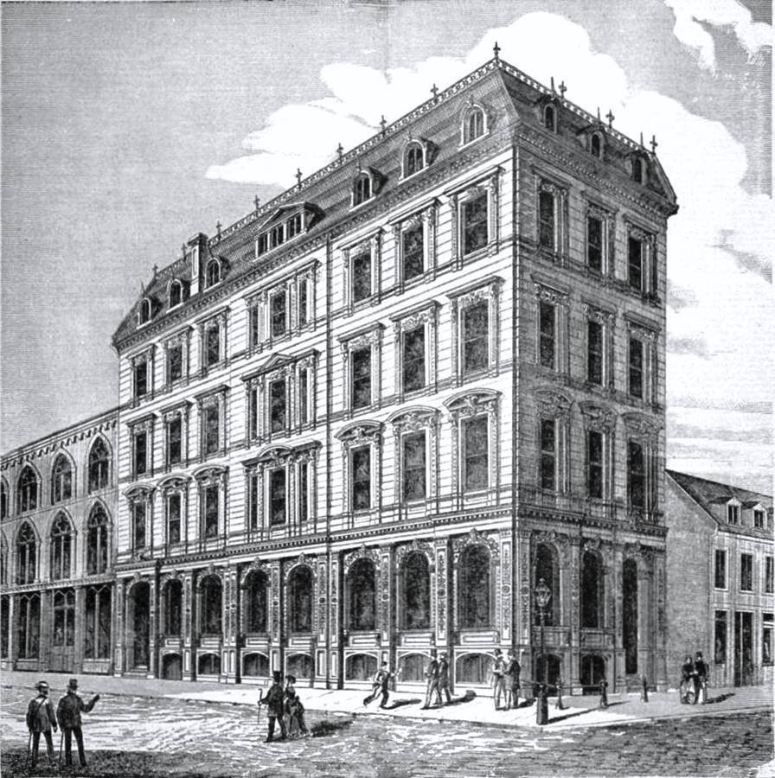


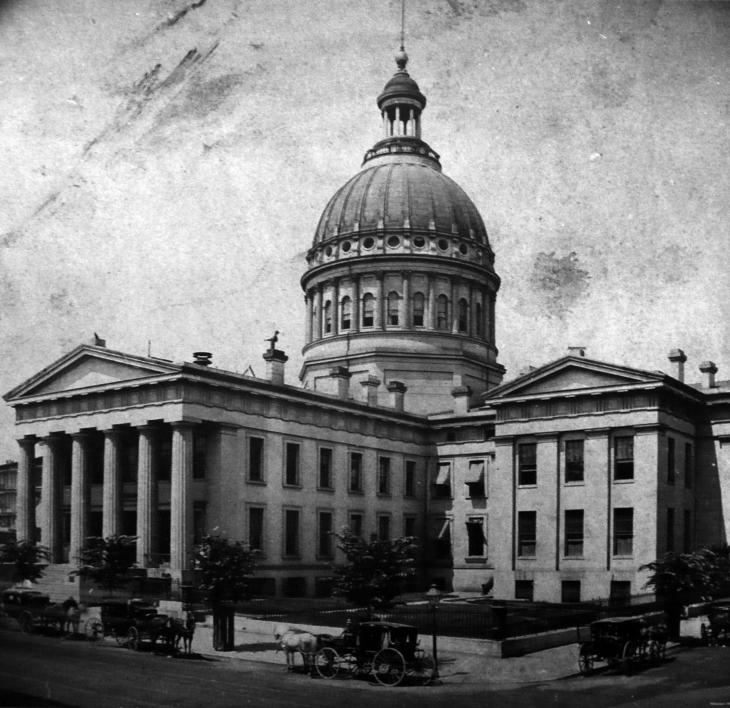
AI is now used in many high-stakes decision making applications
Credit
Employment
Admission
Sentencing

Slide 6
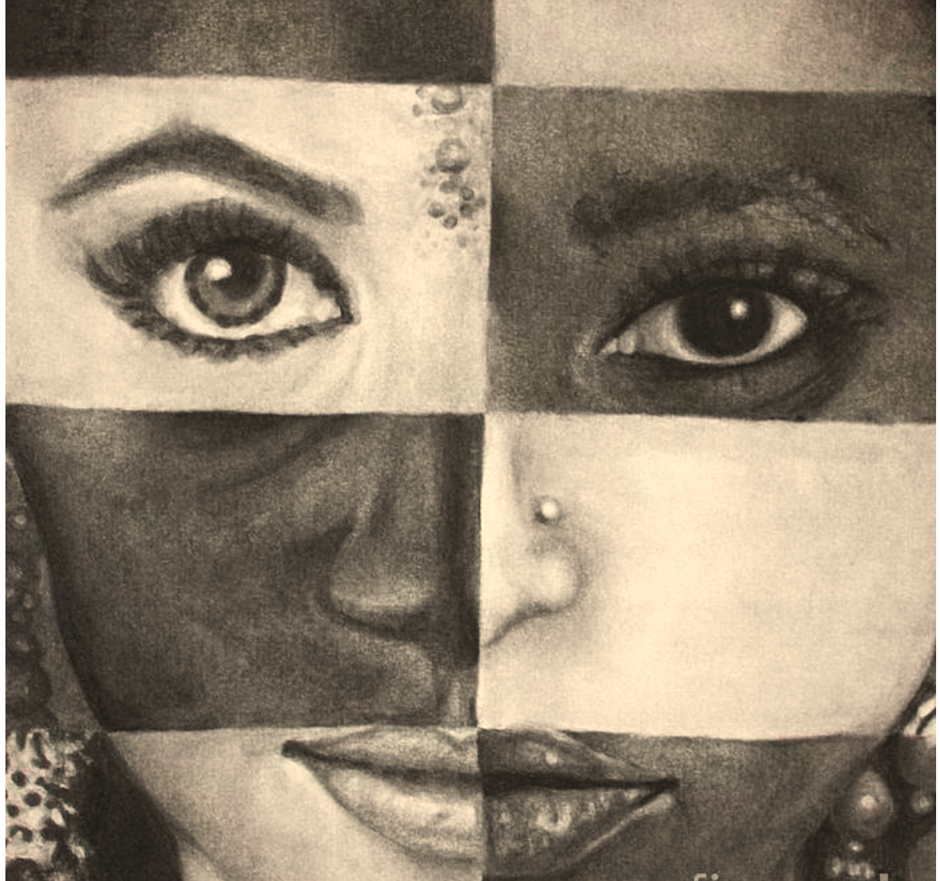
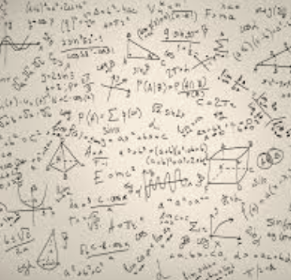

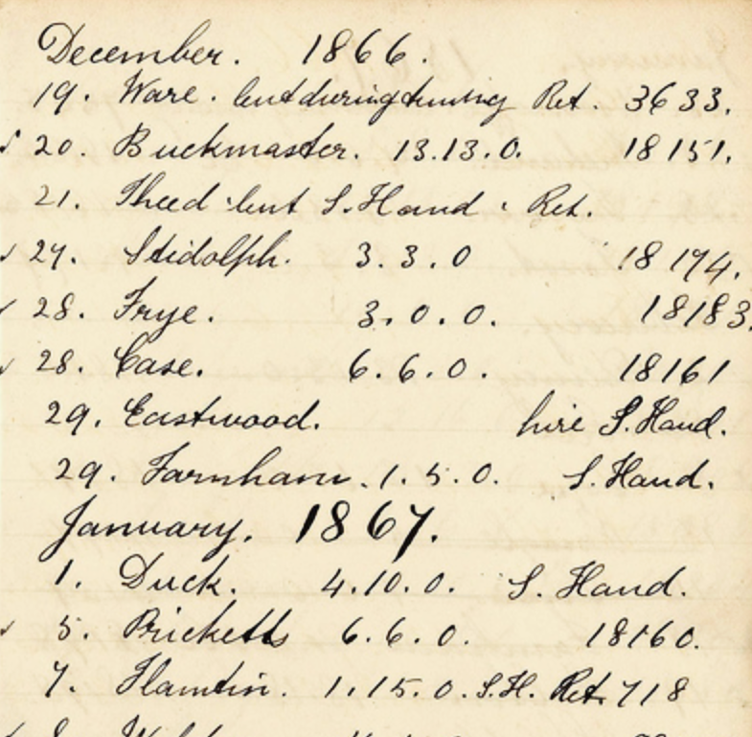
What does it take to trust a decision made by a machine? (Other than that it is 99% accurate)
Is it easy to understand?
Did anyone tamper with it?
Is it fair?
Is it accountable?

Slide 7
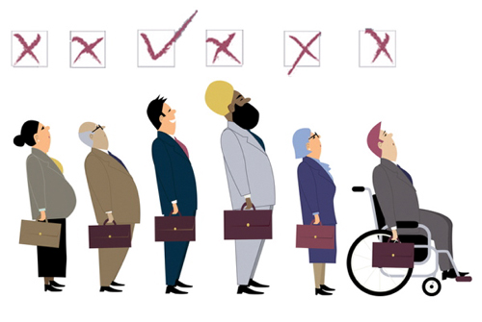
Unwanted bias and algorithmic fairness Machine learning, by its very nature, is always a form of statistical discrimination
Discrimination becomes objectionable when it places certain privileged groups at systematic advantage and certain unprivileged groups at systematic disadvantage
Illegal in certain contexts

Slide 8
Some Examples
Staples Online Pricing¹
Adjust prices based on proximity to competitor stores
Higher prices for lower income people who generally live farther from such stores
Compas Recidivism Data²
Predict risk score for recidivism i.e. re-offend
Racial bias: Black defendants were often predicted to be at a higher risk of recidivism than they actually were; white defendants were often predicted to be less risky than they were
Google Image Tagger³
Offensive labels with images of black people
J. Valentino-Devries, J. Singer-Vine, and A. Soltani, “Websites vary prices, deals based on users’ information,” https://www.wsj.com/articles/SB10001424127887323777204578189391813881534, Dec 2012.
J. Larson, S. Mattu, L.Kirchner and J. Angwin, “How We Analyzed the COMPAS Recidivism Algorithm,” https://www.propublica.org/article/how-we-analyzed-the-compas-recidivism-algorithm, May 2016
J. Guynn, “Google photos labeled black people ’gorillas’,” https://www.usatoday.com/story/tech/2015/07/01/google-apologizes-after-photos-identify-black-people-as-gorillas/29567465/, July 2015

Slide 9
AI Fairness 360 (AIF360)
Open source, Python package - a comprehensive set of
metrics for datasets and models to test for biases,
explanations for these metrics
algorithms to mitigate bias in datasets and models
Interactive demo:
http://aif360.mybluemix.net/data
Additional tutorials/examples
http://aif360.mybluemix.net/resources#
https://github.com/IBM/AIF360/tree/master/examples
Some guidance on choosing metrics/algorithms
http://aif360.mybluemix.net/resources#guidance

Slide 10
Unwanted bias and algorithmic fairness
Unwanted bias in training data yields models with unwanted bias that scale out
Prejudice in labels
Undersampling or oversampling

Slide 11
Statistical definitions of group fairness
situation 1
legend

Slide 12
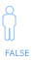
Statistical definitions of group fairness
situation 2
legend

Slide 13
Statistical definitions of group fairness
statistical parity difference
legend

Slide 14
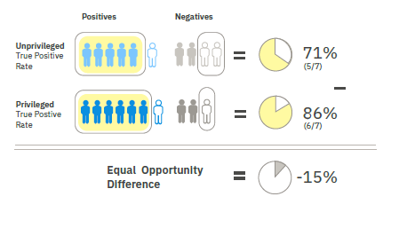
Statistical definitions of group fairness
equal opportunity difference
legend

Slide 15
Statistical definitions of group fairness
disparate impact
legend

Slide 16
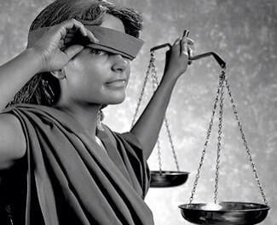
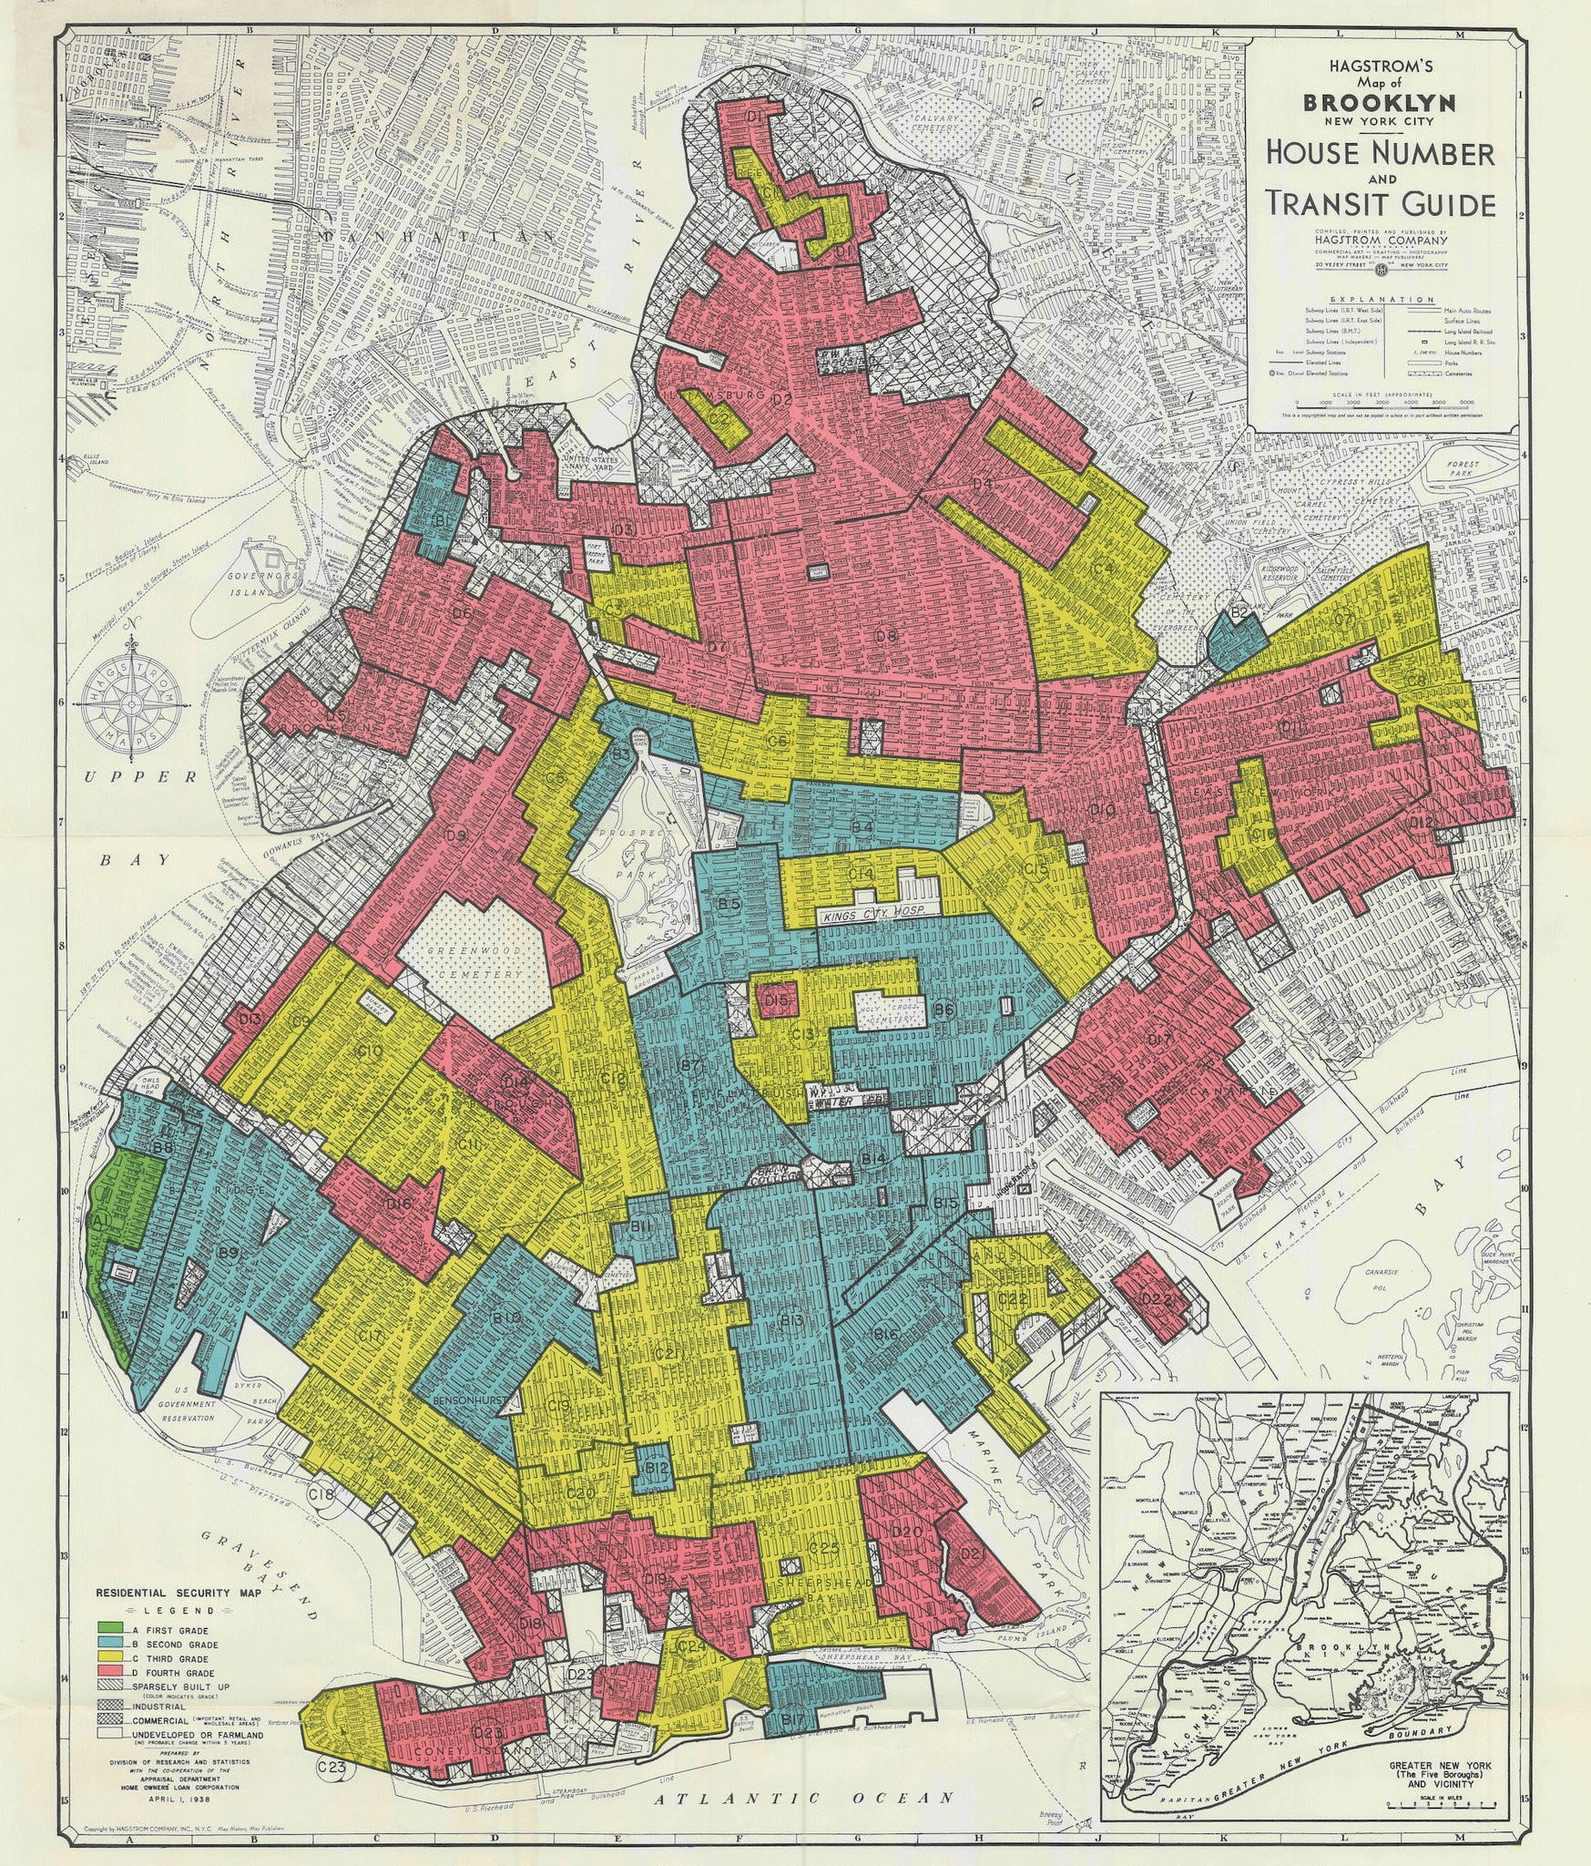
Bias mitigation is not easy Cannot simply drop protected attributes because features are correlated with them

Slide 17
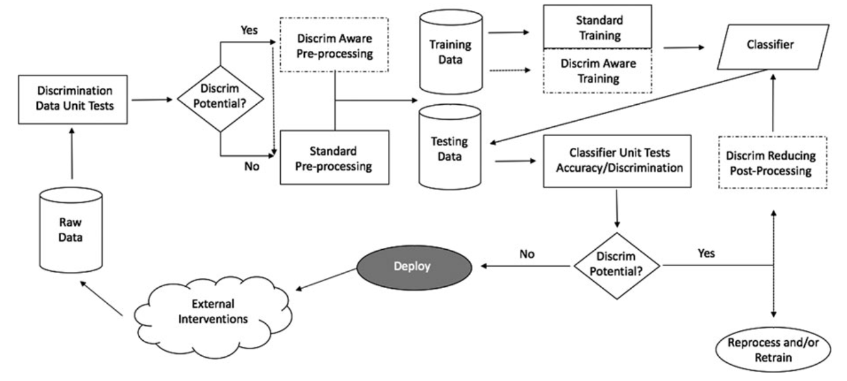
Fairness in building and deploying models
B. d'Alessandro, C. O'Neil and T. LaGatta``Conscientious Classification: A Data Scientist's Guide to Discrimination-Aware Classification’’,
Big Data, 5(2), 2017

Slide 18
Metrics, Algorithms
pre-processing algorithm
in-processing algorithm
dataset metric
post-processing algorithm
classifier metric

Slide 19
Some Pre-Processing Bias Mitigation Algorithms
Pre-Processing techniques attempt to remove underlying bias by changing the input data itself by changing the labels, weights, and/or feature values
ReWeighing: assigns different weights to different training samples to reduce bias
F. Kamiran and T. Calders, "Data Preprocessing Techniques for Classification without Discrimination," Knowledge
and Information Systems, 2012.
Disparate Impact Remover: changes feature values to increase group fairness by trying to break dependence between sensitive features and other features while still trying to maintain model accuracy
M. Feldman, S. A. Friedler, J. Moeller, C. Scheidegger, and S. Venkatasubramanian, "Certifying and removing disparate impact,’’ ACM SIGKDD International Conference on Knowledge Discovery and Data Mining, 2015.
Optimized Pre-Processing: learns a probabilistic transformation that edits the features and labels in the data with group fairness, individual distortion, and data fidelity constraints and objectives
F. P. Calmon, D. Wei, B. Vinzamuri, K. Natesan Ramamurthy, and K. R. Varshney. "Optimized Pre-Processing for Discrimination
Prevention." Conference on Neural Information Processing Systems, 2017

Slide 20
Some In-Processing Bias Mitigation Algorithms
In-Processing techniques change the algorithm itself to reduce bias during model training
Prejudice Remover: adds a discrimination aware regularizer term that penalizes bias during learning
T. Kamishima, S. Akaho, H. Asoh, and J. Sakuma, "Fairness-Aware Classifier with Prejudice Remover Regularizer," Joint European
Conference on Machine Learning and Knowledge Discovery in Databases, 2012.
Adversarial Debiasing: learns a classifier to maximize prediction accuracy and simultaneously reduce an adversary's ability to determine the protected attribute from the predictions. This approach leads to a fair classifier as the predictions cannot carry any group discrimination information that the adversary can exploit.
B. H. Zhang, B. Lemoine, and M. Mitchell, "Mitigating Unwanted Biases with Adversarial Learning," AAAI/ACM Conference on Artificial
Intelligence, Ethics, and Society, 2018.

Slide 21
Some Post-Processing Bias Mitigation Algorithms
In-Processing techniques change the model output to reduce bias
Equalized Odds Post Processing: that solves a linear program to find probabilities with which to change output labels to optimize equalized odds
G. Pleiss, M. Raghavan, F. Wu, J. Kleinberg, and K. Q. Weinberger, "On Fairness and Calibration," Conference on Neural Information
Processing Systems, 2017.
Reject Option Classification: gives favorable outcomes to unprivileged groups and unfavorable outcomes to privileged groups in a confidence band around the decision boundary with the highest uncertainty.
F. Kamiran, A. Karim, and X. Zhang, "Decision Theory for Discrimination-Aware Classification," IEEE International Conference on Data
Mining, 2012.

Slide 22
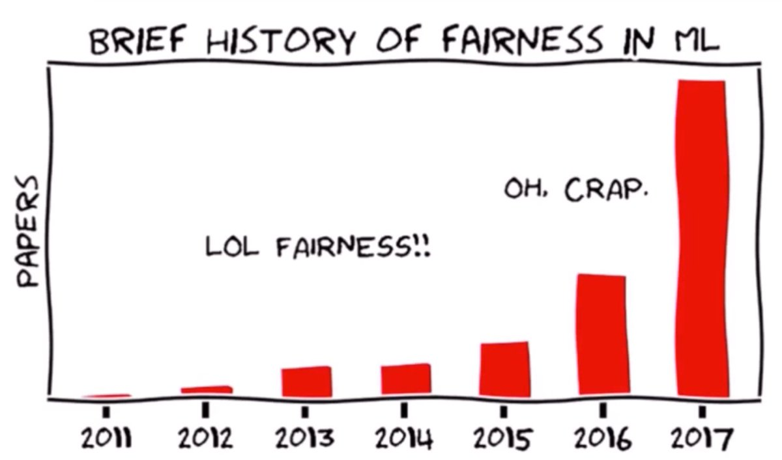
Research Algorithmic fairness is one of the hottest topics in the ML/AI research community
(Hardt, 2017)

Slide 23
Many other open source fairness libraries...
Fairness Measures | Framework to test given algorithm on variety of datasets and fairness metrics | https://github.com/megantosh/fairness_measures_code
Fairness Comparison | Extensible test-bed to facilitate direct comparisons of algorithms with respect to fairness measures. Includes raw & preprocessed datasets | https://github.com/algofairness/fairness-comparison
Themis-ML | Python library built on scikit-learn that implements fairness-aware machine learning algorithms | https://github.com/cosmicBboy/themis-ml
FairML | Looks at significance of model inputs to quantify prediction dependence on inputs | https://github.com/adebayoj/fairml
Aequitas | Web audit tool as well as python lib. Generates bias report for given model and dataset | https://github.com/dssg/aequitas
Fairtest | Tests for associations between algorithm outputs and protected populations | https://github.com/columbia/fairtest
Themis | Takes a black-box decision-making procedure and designs test cases automatically to explore where the procedure might be exhibiting group-based or causal discrimination | https://github.com/LASER-UMASS/Themis
Audit-AI | Python library built on top of scikit-learn with various statistical tests for classification and regression tasks | https://github.com/pymetrics/audit-ai

